Slide 1
Single source
unweighted path lengths

Slide 2
Outline
This topic looks at another problem solved by breadth-first traversals
Determining if a graph is bipartite
Definition of a bipartite graph
The algorithm
An example

Slide 3
Definition
Definition
A bipartite graph is a graph where the vertices V can be divided into two disjoint sets V₁ and V₂ such that every edge has one vertex in V₁ and the other in V₂

Slide 4
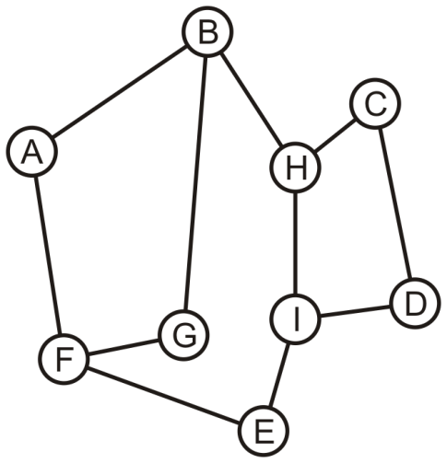
Bipartite Graphs
Consider this graph: is it bipartite?

Slide 5
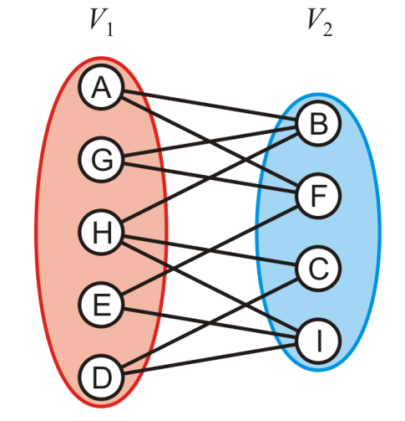
Bipartite Graphs
Yes: With a little work, it is possible to determine that we can decompose the vertices into two disjoint sets

Slide 6
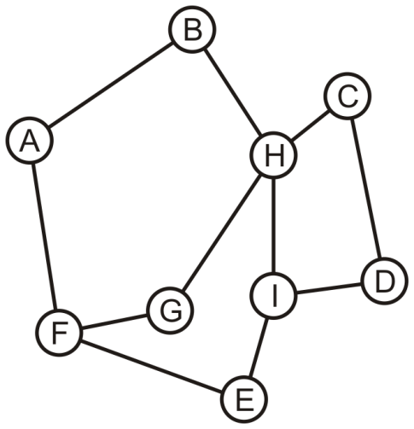
Bipartite Graphs
Is this graph bipartite?

Slide 7
Bipartite Graphs
In this case, it is not a bipartite graph
Can we find a traversal that will determine if a graph is bipartite?

Slide 8
Bipartite Graphs
Consider using a breadth-first traversal for a connected graph:
Choose a vertex, mark it belonging to V₁ and push it onto a queue
While the queue is not empty, pop the front vertex v and
Any adjacent vertices that are already marked must belong to the set not containing v, otherwise, the graph is not bipartite (we are done); while
Any unmarked adjacent vertices are marked as belonging to the other set and they are pushed onto the queue
If the queue is empty, the graph is bipartite

Slide 9
Bipartite Graphs
With the first graph, we can start with any vertex
We will use colours to distinguish the two sets

Slide 10
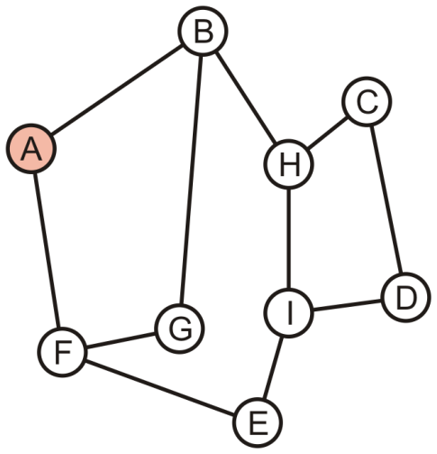
Bipartite Graphs
Push A onto the queue and colour it red
A

Slide 11
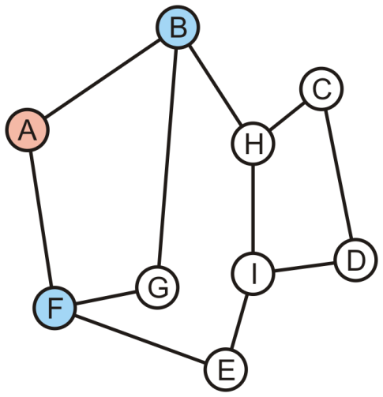
Bipartite Graphs
Pop A and its two neighbours are not marked:
Mark them as blue and push them onto the queue
B | F

Slide 12
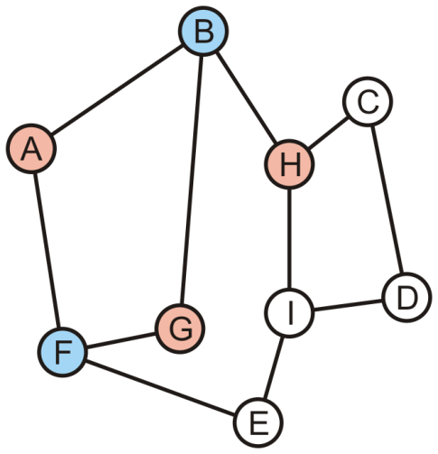
Bipartite Graphs
Pop B—it is blue:
Its one marked neighbour, A, is red
Its other neighbours G and H are not marked: mark them red and push them onto the queue
F | G | H

Slide 13
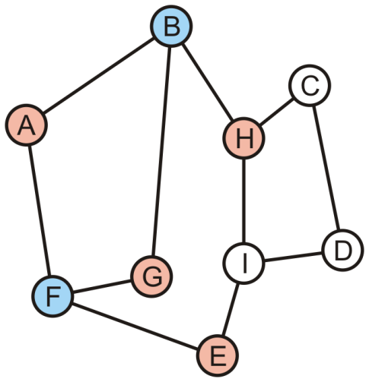
Bipartite Graphs
Pop F—it is blue:
Its two marked neighbours, A and G, are red
Its neighbour E is not marked: mark it red and pus it onto the queue
G | H | E

Slide 14
Bipartite Graphs
Pop G—it is red:
Its two marked neighbours, B and F, are blue
H | E

Slide 15
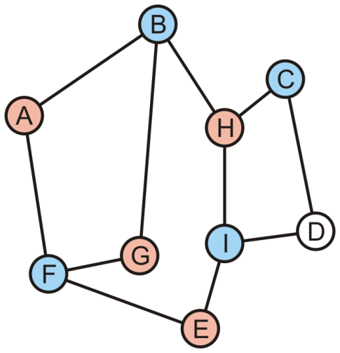
Bipartite Graphs
Pop H—it is red:
Its marked neighbours, B, is blue
It has two unmarked neighbours, C and I; mark them blue and push them onto the queue
E | C | I

Slide 16
Bipartite Graphs
Pop E—it is red:
Its marked neighbours, F and I, are blue
C | I

Slide 17
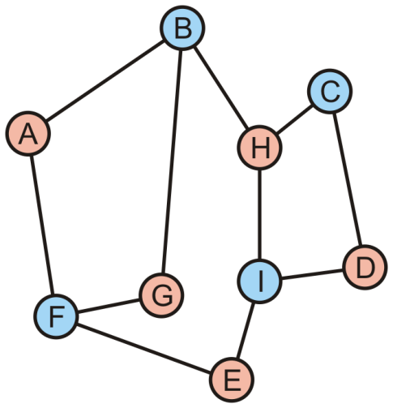
Bipartite Graphs
Pop C—it is blue:
Its marked neighbour, H, is red
Mark D as red and push it onto the queue
I | D

Slide 18
Bipartite Graphs
Pop I—it is blue:
Its marked neighbours, H, D and E, are all red
D

Slide 19
Bipartite Graphs
Pop D—it is red:
Its marked neighbours, C and I, are both blue

Slide 20
Bipartite Graphs
The queue is empty, the graph is bipartite

Slide 21
Bipartite Graphs
Consider the other graph which was claimed to be not bipartite

Slide 22
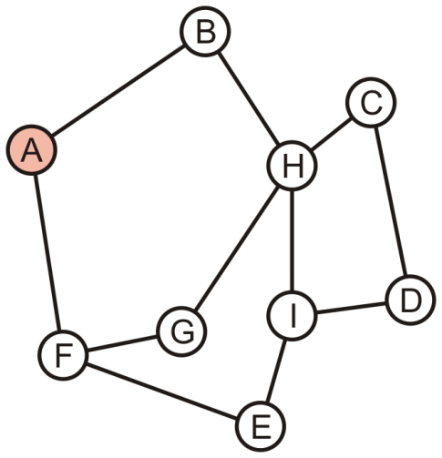
Bipartite Graphs
Push A onto the queue and colour it red
A

Slide 23
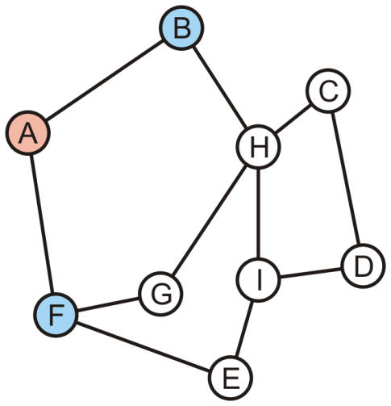
Bipartite Graphs
Pop A off the queue:
Its neighbours are unmarked: colour them blue and push them onto the queue
B | F

Slide 24
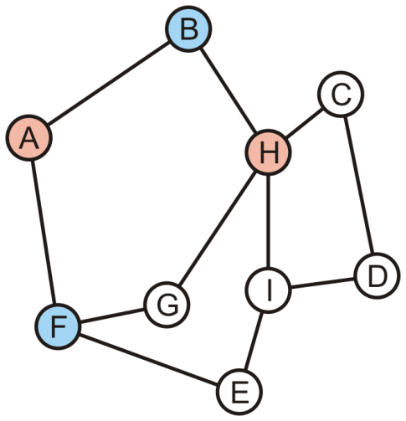
Bipartite Graphs
Pop B off the queue:
Its one neighbour, A, is red
The other neighbour, H, is unmarked: colour it red and push it onto the queue
F | H

Slide 25
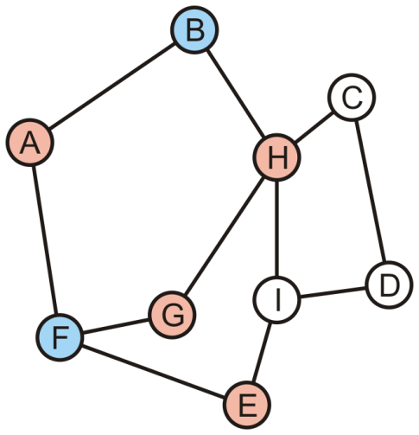
Bipartite Graphs
Pop F off the queue:
Its one neighbour, A, is red
The other neighbours, E and G, are unmarked: colour them red and push it onto the queue
H | E | G

Slide 26
Bipartite Graphs
Pop H off the queue—it is red:
Its one neighbour, G, is already red
The graph is not bipartite
E | G

Slide 27
Bipartite Graphs
Definition
Cycles that contains either an even number or an odd number of vertices are said to be even cycles and odd cycles, respectively
Theorem
A graph is bipartite if and only if it does not contain any odd cycles
Reference: Kleinberg and Tardos

Slide 28
Sumary
This topic looked at identifying bipartite graphs
Perform a breadth-first traversal
Each vertex is given one of two identifiers (we used color)
The first vertex is identified as one color and pushed onto the queue
When a vertex is popped:
Each unvisited neighbor is pushed onto the tree with the opposite color
Each visited neighbor must be the opposite color
If one is not, the graph is not bipartite

Slide 29
References
Wikipedia, http://en.wikipedia.org/wiki/Breadth-first_search#Testing_bipartiteness
http://en.wikipedia.org/wiki/Breadth-first_search
http://en.wikipedia.org/wiki/Bipartite_graph
[1] Jon Kleinberg and Éva Tardos, Algorithm Design, Addison Wesley, 2006, §§3.2-5, pp.78-99.
These slides are provided for the ECE 250 Algorithms and Data Structures course. The material in it reflects Douglas W. Harder’s best judgment in light of the information available to him at the time of preparation. Any reliance on these course slides by any party for any other purpose are the responsibility of such parties. Douglas W. Harder accepts no responsibility for damages, if any, suffered by any party as a result of decisions made or actions based on these course slides for any other purpose than that for which it was intended.

